Slide 1


Jeffrey Andes
Dec 22, 2023

Slide 2

Outline
Executive Summary
Introduction
Methodology
Results
Conclusion
Appendix

Slide 3
Executive Summary
Methodology:
Extracted the data using REST API and Web scraping
Wrangled the data to fill in missing pieces and create numerical values for categorical data
Performed Visual Analysis on the data to see if there was any insight or correlations that can be acquired.
Created interactive maps and a dashboard to help drill down further.
Performed a CV Grid Search with several different classification types to arrive at the best model for predictive success and failure of a mission.
Results:
The visual map is telling to highlight location for where launches occur from
The Payload Mass influences the overall success rate of the mission
A predictive model can be created with a strong accuracy for data available.

Slide 4
Introduction
Background
Commercial space flight has become very competitive recently with several companies offering a service.
The most successful has been SpaceX with their Falcon 9 rocket.
A new company is looking to join this industry, following the SpaceX model will they be successful?
Questions to answer:
How much does it cost SpaceX to launch each rocket?
Will the booster be recovered?
Will the launch be a success?

Slide 5

Section 1

Slide 6
Methodology
Executive Summary
Data collection methodology:
Used SpaceX API to collect data
Use Web scraping on Wikipedia to collect data
Perform data wrangling
Using Pandas, we verified the relevant data was present and created our target in pass or fail.
Perform exploratory data analysis (EDA) using visualization and SQL
Perform interactive visual analytics using Folium and Plotly Dash
Perform predictive analysis using classification models
Set-up a Grid Search CV and performed on multiple model types to determine the best.

Slide 7
Data Collection
SpaceX API
Used the requests library to access the SpaceX API and pull relevant data that we turned into our initial data frame.
Wikipedia Web Scraping
Used the Falcon 9 and Falcon Heavy Wikipedia page to pull launch data from the table along with the outcome.

Slide 8
Data Collection – SpaceX API
Used the Requests library to access the REST API and receive a response back in JSON format.
Then transformed the JSON format into a data frame that can be worked through Pandas
API Notebook
Request API Call to URL
Response Received in JSON
Check Response Code to Verify Request Worked
Use Pandas to transform JSON data into a Database

Slide 9
Data Collection - Scraping
Used BeautifulSoup and requests libraries to access the URL and pull the desired data. Once the HTML data was retrieved, used the elements to access the pieces desired to build my data frame from.
Web Scraping Notebook
Use the Requests function to get an HTML response from the URL
Create a BeautifulSoup object from the response
Access the element table to pull the desired data from this URL (3rd table)
Loop through extracted row to place into our data frame.

Slide 10
Data Wrangling
Using Pandas we checked for missing data and based on the % missing either removed the lines or updated with a best approximation using either the mean of the present data or the most frequent depending on what was appropriate for the data that was missing.
From the landing outcomes created a success for failure target represented as 1 or 0.
Check data types and adjust numerical and data columns accordingly.
API Notebook with Data Wrangling at the End
Data Wrangling Notebook
Check For Missing Data
Identify how to handle missing data
Update Appropriate Rows
Create numerical target from Category
Check data types
Update Dates and Numbers accordingly

Slide 11
EDA with Data Visualization
Scatter Plots
Payload Mass vs Flight Number – See if the weight contributed to the success for failure
Launch Site vs Flight Number – Are launches more successful at one site then another?
Payload Mass vs Launch Site – Does one site handle heavy or light loads better then others?
Orbit vs Flight Number – Does the orbit effect the success rate, has one orbit become more consistant?
Orbit vs Payload Mass – Is the a correlation between orbit and payload in relation to success?
Bar Chart
Orbits vs Outcome – Which orbits have better success rates?
Line Graph
Date (Year) vs Outcome – Has the success rate improved over the years at SpaceX?
EDA Data Visualization Notebook

Slide 12
EDA with SQL
Identify the Unique Launch Sites
Review a few CCA Launch Sites
Calculate the total payload mass carried for NASA (CRS) as the customer
Calculate the average payload mass carried by the Falcon 9 v1.1 booster
Date of the first successful ground pad landing
Boosters with successful drone ship landing carrying a payload in a given range
Listing of the count of successful and failed missions
List of the boosters that carried the max payload
List of the month, booster and launch site that had a failed drone ship landing in 2015
Rank of the landing outcomes in a given date range in descending order
EDA SQL Notebook

Slide 13
Build an Interactive Map with Folium
On an interactive map there are the following features:
Circled – Launch Sites
Marked – Each successful and failed launch
Line and Distance – To The nearest coastline, highway, railroad and city.
On the map these features give a visual representation of where rockets are launch from and how successful they are. Along with an idea of the infostructure in highways and railroads that might be needed to access the launch site. Additionally, the proximity or distance from a city and coastline appears to be important when planning where you would build your own launch site.
Folium Map Notebook

Slide 14
Build a Dashboard with Plotly Dash
Plots/Graphs
Pie plot to show the breakdown of successful launches between the sites
Pie plot to show the breakdown of successful vs failed launches at 1 chosen site
Scatter plot between the payload mass and outcome class while highlighting the different boosters to show at what mass the success rate increases or decreases for and which boosters have worked the best.
Interactions
A dropdown menu helps provide the ability to look at all launch sites or focus on just one.
A Slider for the payload mass that can be toggled to select the payload range to look at.
Plotly Dash Python code

Slide 15
Predictive Analysis (Classification)
Following the method of standardizing the data to make sure no 1 parameter has a larger influence on the prediction then another we split the data into test and train.
Then to help with under and over fitting we did a CV training of the model with our GridSearch to get our hyperparameters.
We repeated this to collect the score for several different classification methods in order to arrive at the best for this task.
ML Predictive Analysis Notebook
Standardize
Test/Train Split
Create Parameters for Grid Search
Perform CV GridSearch on Train Data
Review Best Hyperparameters
Score on Test
Repeat for other Classification Methods
Review Scores to find the best method

Slide 16
Results
Used SQL and Seaborn with Pandas to do initial Exploratory data analysis.
Reviewed data through Scatter Plots, Bar Charts and Line Graphs.
In SQL we looked at Unique Launch Sites, Booster Success and Failures, different time periods, average payload as well at total payload.
Through Folium and Plotly we can have some interactive exploration of that data as capture in screen shots for this presentation.
With Folium we created visual maps to see where the launch sites are located and outcome of launch at each site.
We also looked at proximity to key infostructure and cities.
With Plotly we created a dashboard that is captured in screen shots to see success vs failure along with how the payload effect it for the different launch sites.
Performed Predictive Analysis
Used CV Grid Search with several different classification approaches.
After we were able to compare the different approaches to see which one was most accurate.

Slide 17

Section 2

Slide 18
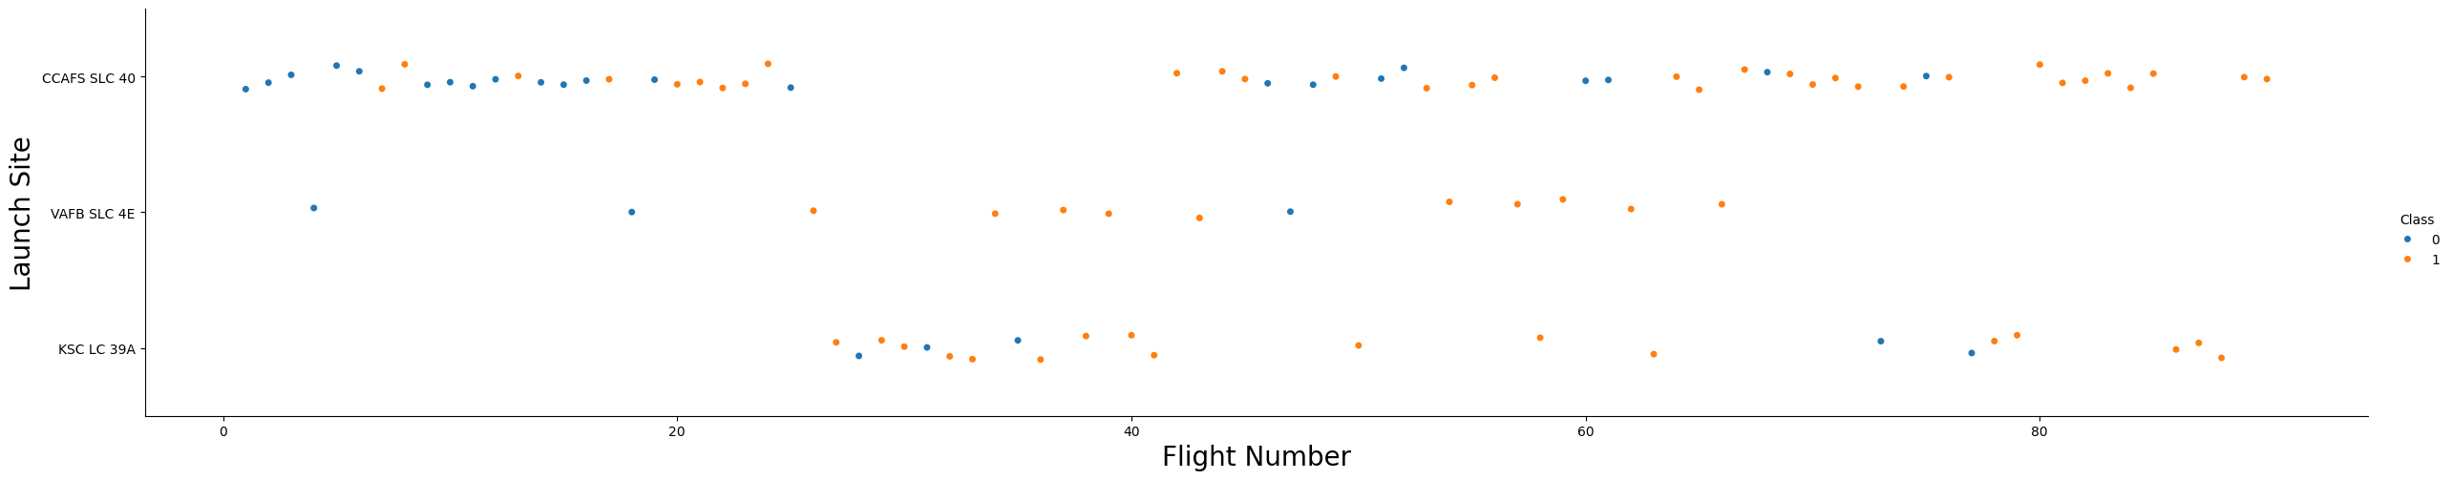
Flight Number vs. Launch Site
We can see that different launch sites have higher success rates even in the higher flight numbers, but all launch sites appear to get have more success in general at the high flight numbers.

Slide 19
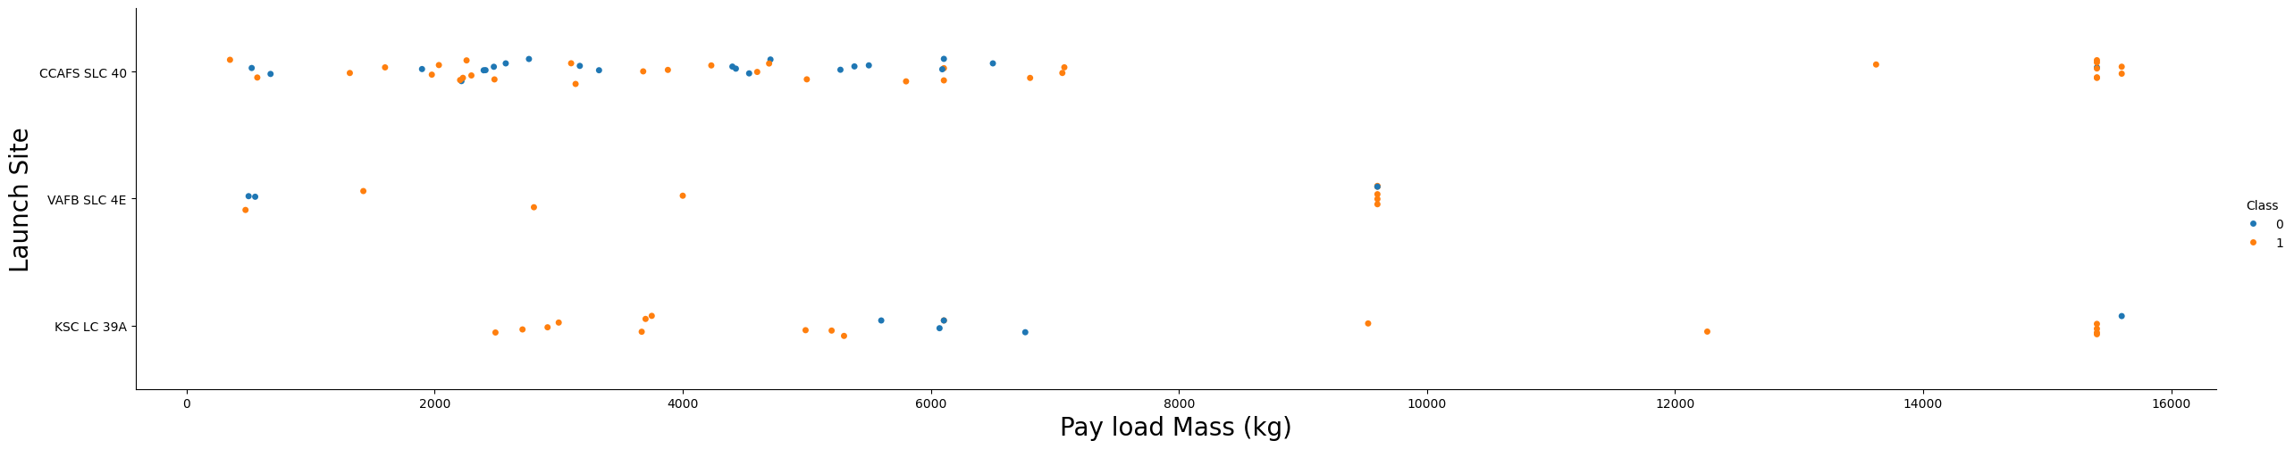
Payload vs. Launch Site
Now if you observe Payload Vs. Launch Site scatter point chart you will find for the VAFB-SLC launch site there are no rockets launched for heavy payload mass (greater than 10000).

Slide 20
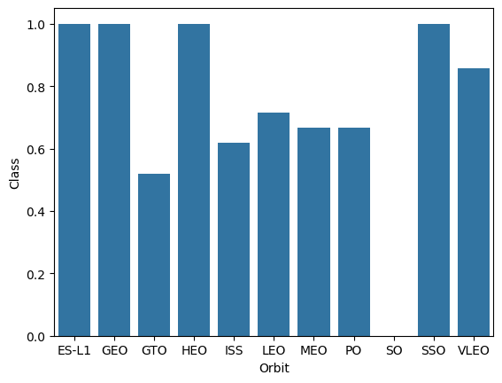
Success Rate vs. Orbit Type
There are several orbits (ES-L1, GE, HEO and SSO) with 100% success rate as shown on the bar chart with VLEO also having a high success rate over 80%.
The orbits of GTO and SO do not have a good success rate.

Slide 21
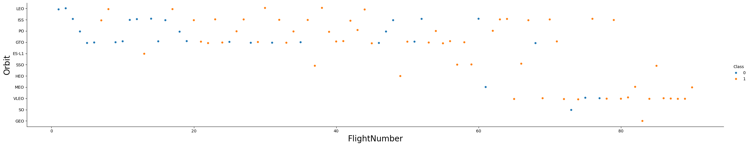
Flight Number vs. Orbit Type
You should see that in the LEO orbit the success appears related to the number of flights.
On the other hand, there seems to be no relationship between flight number when in GTO orbit.

Slide 22
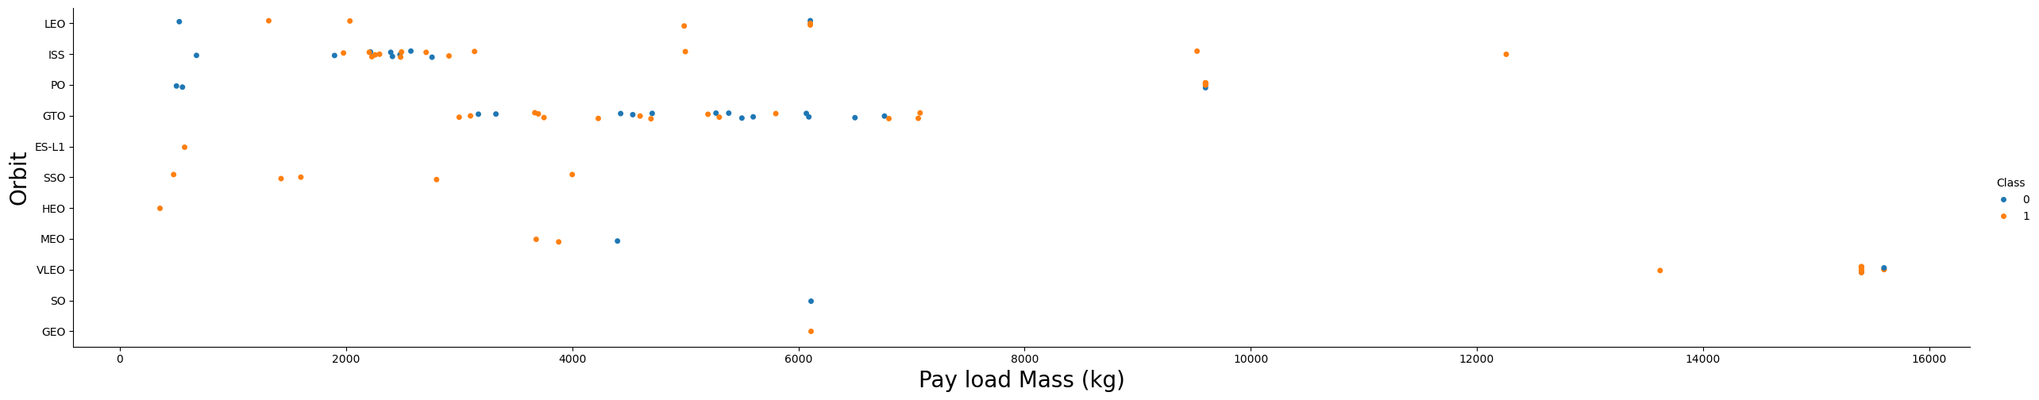
Payload vs. Orbit Type
With heavy payloads the successful landing or positive landing rate are more for Polar, LEO and ISS.
However, for GTO we cannot distinguish this well as both positive landing rate and negative landing(unsuccessful mission) are both there here.

Slide 23
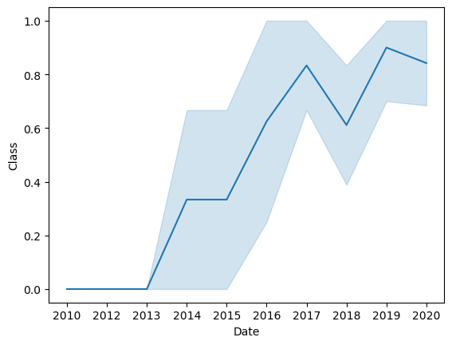
Launch Success Yearly Trend
You can observe that the overall success rate since 2013 kept increasing till 2018
After 2018 the success increased again in 2019 but decreased in 2020 again.
However, the overall success appears on an upward trend from where it started in 2013.

Slide 24
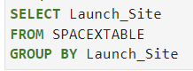
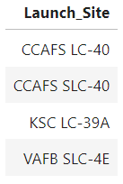
All Launch Site Names
After we pulled the data, we wanted to see how many unique launch sites rockets launched from.
Using SQL, we were able to do a quick query to see that there are 4 different launch sites used.
In SQL we were able to get this list by grouping the data by Launch Site.

Slide 25
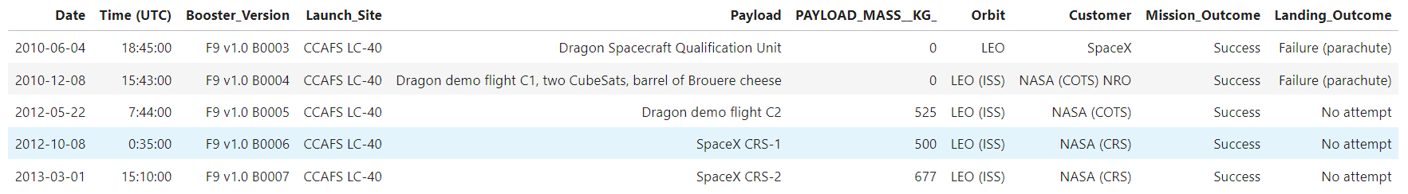
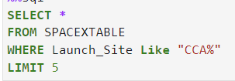
Launch Site Names Begin with 'CCA'
With 2 sites having CCA in the name we wanted to take a closer look at a few of the records.
Using the “Where” clause in our SQL query along with limiting our results to 5 we were able to get a snapshot of what type of launches originated from these 2 sites.

Slide 26
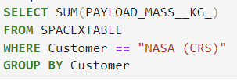
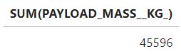
Total Payload Mass
We want to get an idea of how much Payload has been launched for NASA as the customer.
In SQL this is a quick sum while limiting the records we look at to just NASA as the customer.
The group by allows SQL to add up the desired records we want to know the totals for, in this case the customer that is NASA.

Slide 27
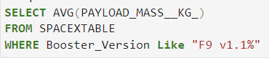
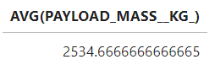
Average Payload Mass by F9 v1.1
We want to get a quick idea of what the average payload has been using a specific rocket booster.
Using the AVG function in SQL and limiting the booster version gives us the quick reference we are looking for.

Slide 28
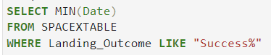
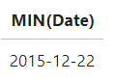
First Successful Ground Landing Date
How long has Space X been able to pull off a successful ground landing?
How long after the first rocket launch were they able to successfully land?
In order to start answering these questions we need to know when the first successful landing occurred.
Using the MIN function on the date and limiting out results to only successful outcomes we can find this date.

Slide 29
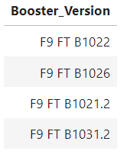
Successful Drone Ship Landing with Payload between 4000 and 6000
We seen in the scatter plots that a payload between 4000-6000 has a lot of data point.
So which boosters were used within this range and were successful
Using the WHERE clause in SQL we can limit our results to see only the boosters with a successful outcome in that payload range.

Slide 30
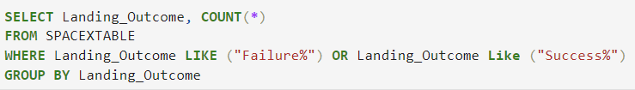
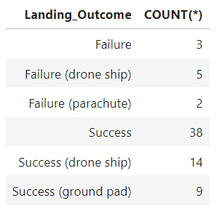
Total Number of Successful and Failure Mission Outcomes
What type of outcomes were achieved and how many of each?
Using a count and grouping by the Landing Outcome we can get these numbers.
We also want to make sure we only look at successes and failures, as it appears there were times when the outcome didn’t matter.

Slide 31
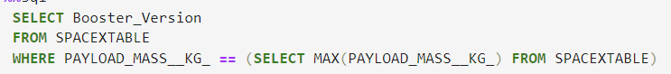
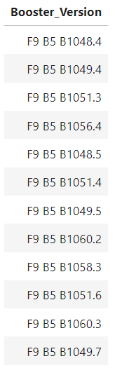
Boosters Carried Maximum Payload
We wanted to see which boosters carried were used with the max payload.
First, we needed to know the max payload that was carried, then use that number within our query to limit our results to only those records that carried the max payload.

Slide 32
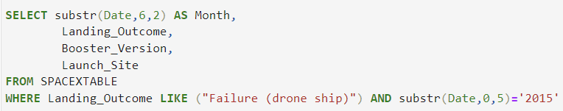
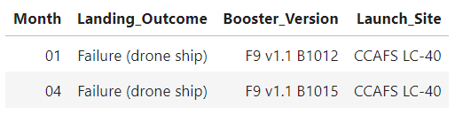
2015 Launch Records
We know that in 2015 there was a successful ground landing, but were they also testing drone ship landing and how many times did they fail if they were?
We can see they made 2 failed attempts at the beginning of the year (January and February).
We were able to look at this data by limiting our results based on outcome and the year portion of the date.

Slide 33
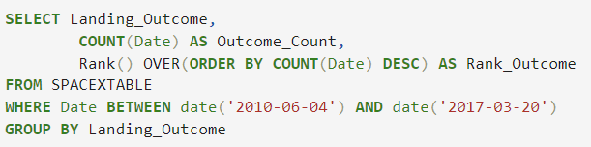
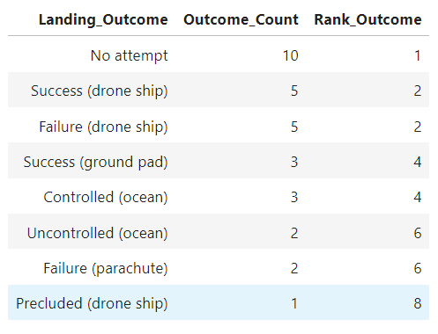
Rank Landing Outcomes Between 2010-06-04 and 2017-03-20
Between June 2010 and March 2017, we wanted to see how the rocket testing and missions went at Space X.
We wanted to see the results ranked in most frequent outcome to least frequent within that date range.

Slide 34

Section 3

Slide 35
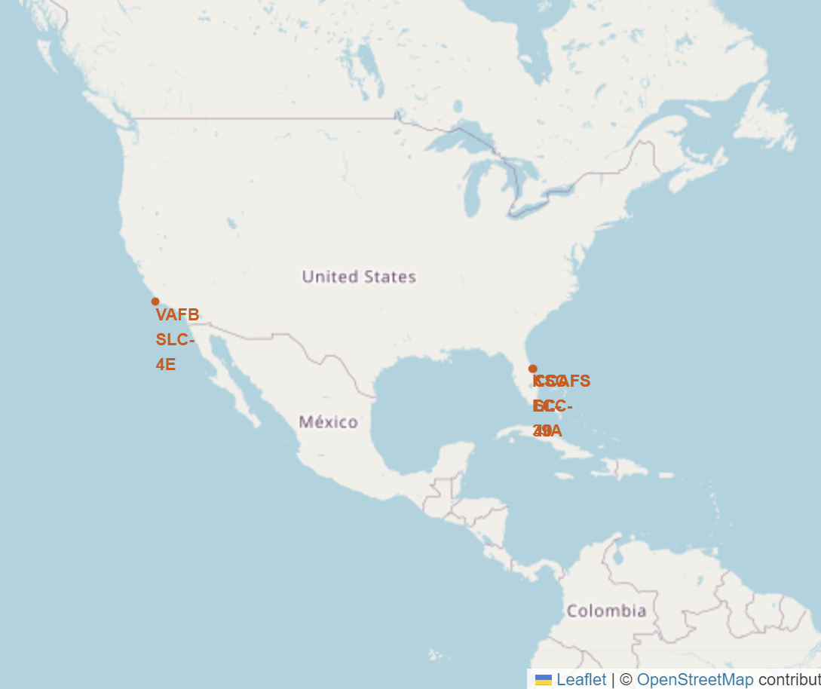
Launch Sites Map
The 4 launch sites are all located in the United States with 3 of them being very close together on the southeastern coast.
Their locations are marked and circled on the map along with the site names marked for easy identification.
Ocean coastline appears to be import to their placement.

Slide 36
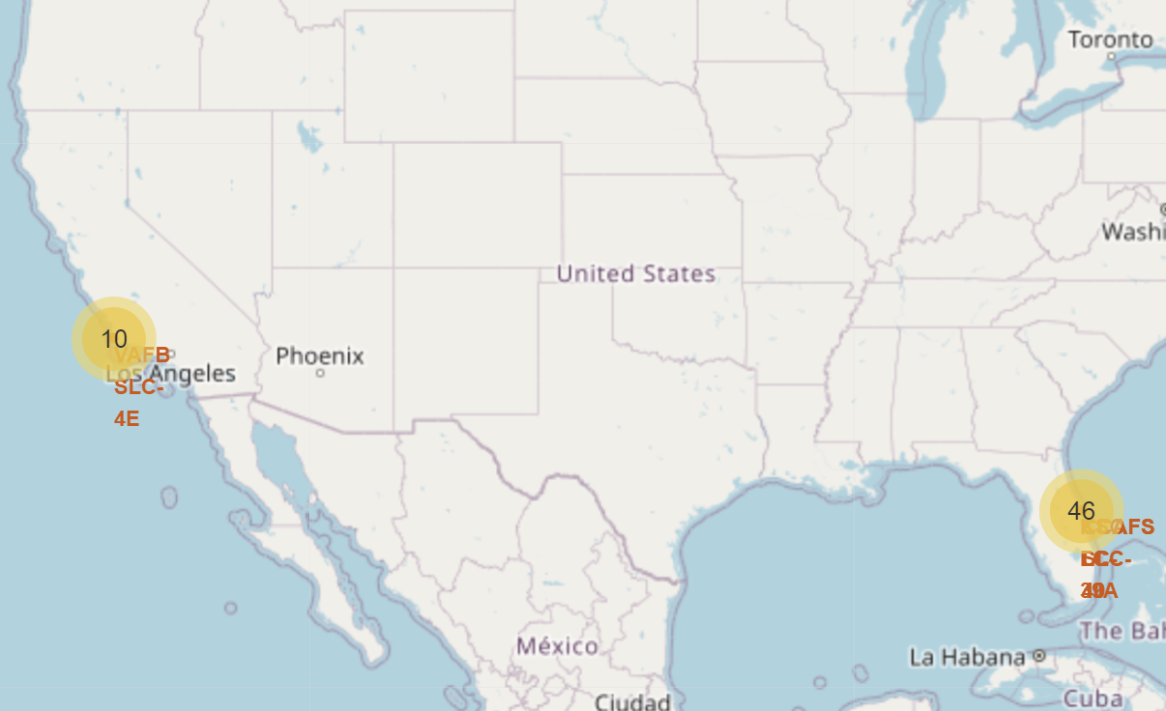
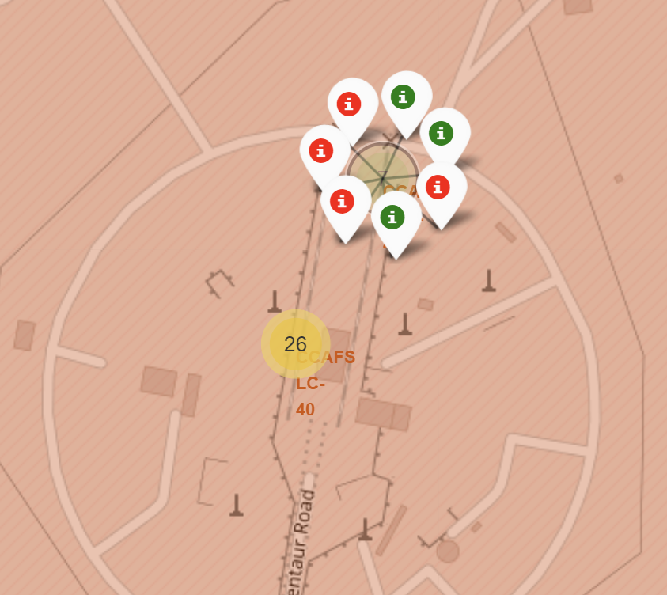
Global Map with Successes and Failures Marked
With the launches marked on the map we can see where the majority have launched from.
When zoomed in we can see the successes (green) and failures (red) also marked on the map.

Slide 37
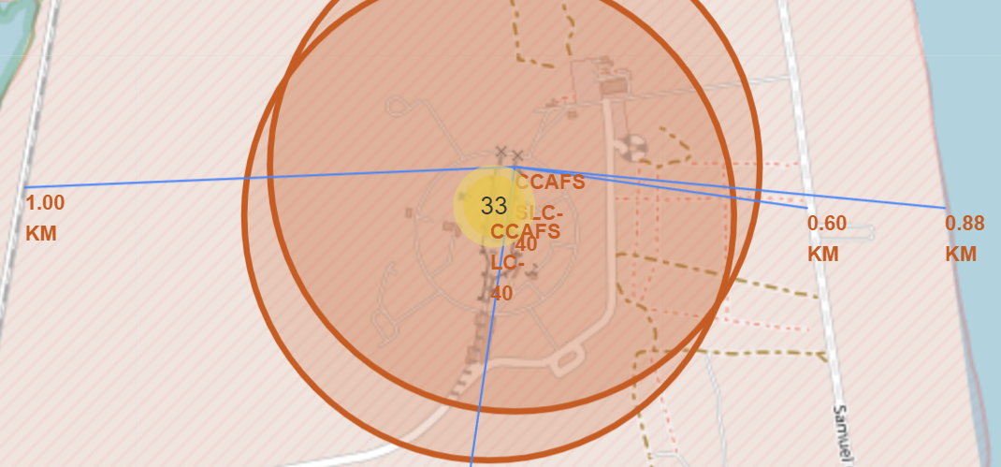
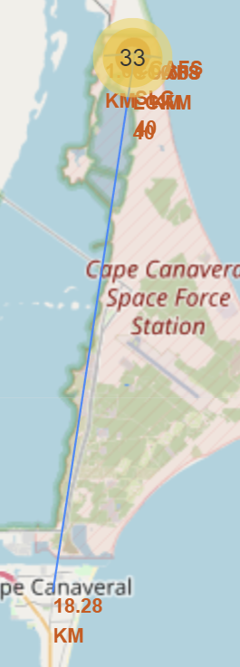
Proximities Map
Looking at the distance from launch site to coastline, highway, railroad and city we see that usually launch sites are close to the coast, highway and railroad, but located a distance away from any city. This is import for planning any future launch sites.

Slide 38

Section 4

Slide 39
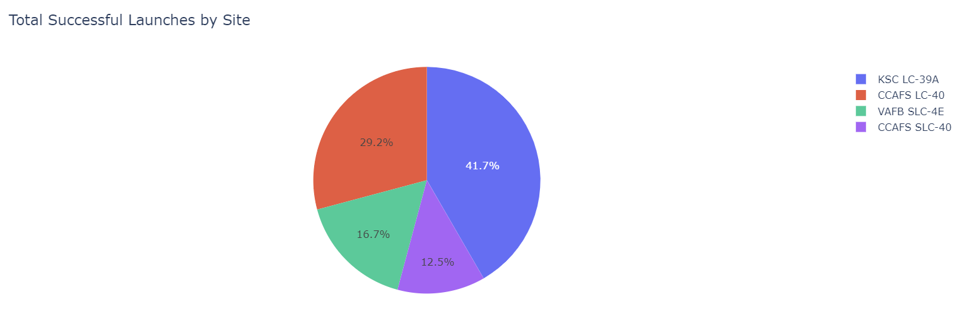
Successful Launches by Launch Site
Through the pie chart we can see the breakdown of which sites more successful launches have come from, with KSC LC-39A account for over 40% of the successful launches.

Slide 40
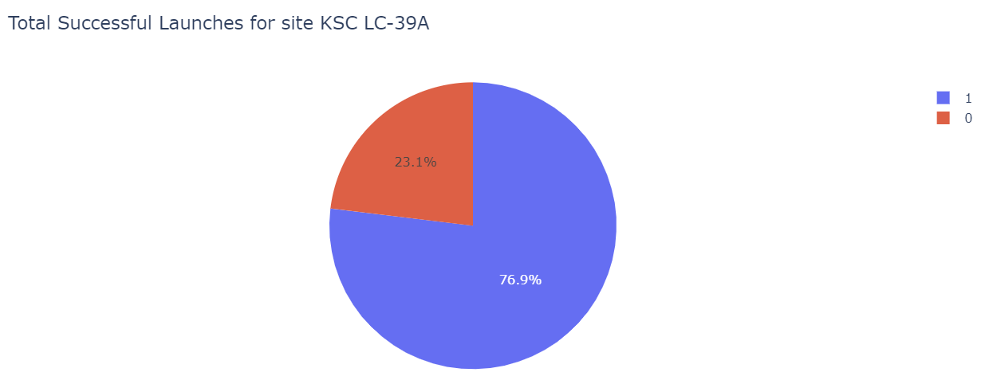
KSC LC-39A Successful Launch Percentage
In this pie chart we can see that launches form KSC LC -39A are successful on over 75% of their launches. We can see this in the blue section that is the portion that has a successful outcome.

Slide 41
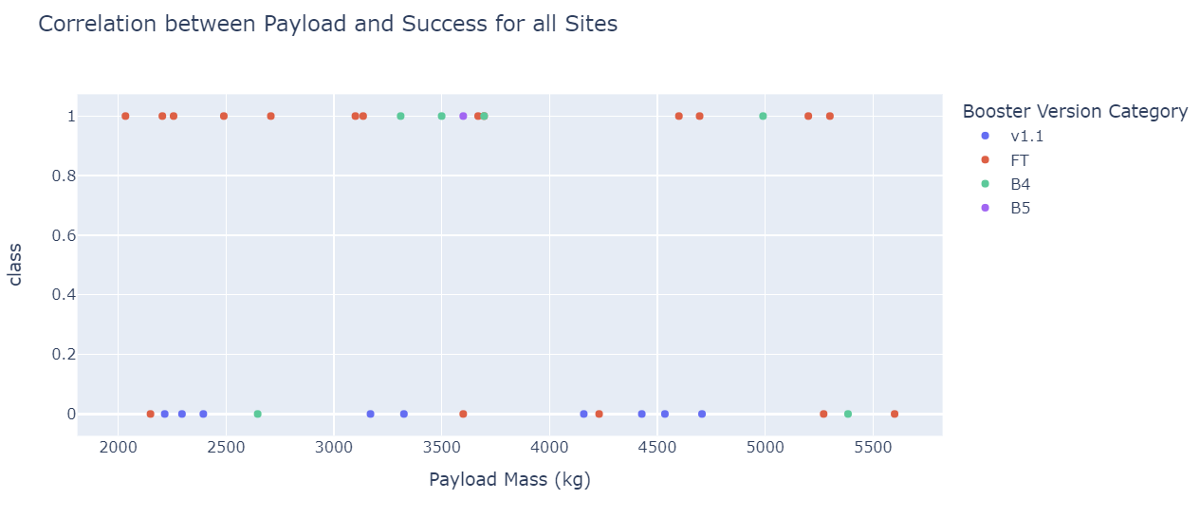
Correlation between Payload and Success
Most of the launches were between 2000 and 6000kg so highlighting that here. You can also see in this range that both the FT and B4 boosters appear to have a high success rate with payloads under 5000kg being very successful.

Slide 42

Section 5

Slide 43
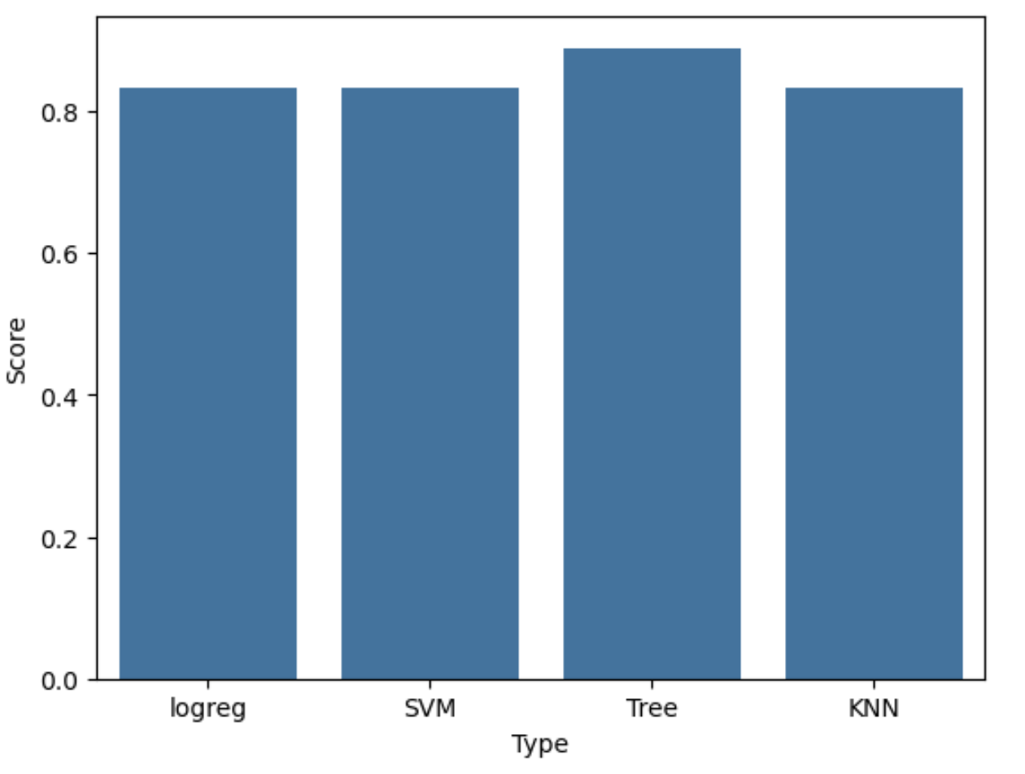
Classification Accuracy
The Decision Tree model has the highest Accuracy Score.
This will be the model we chose to use.

Slide 44
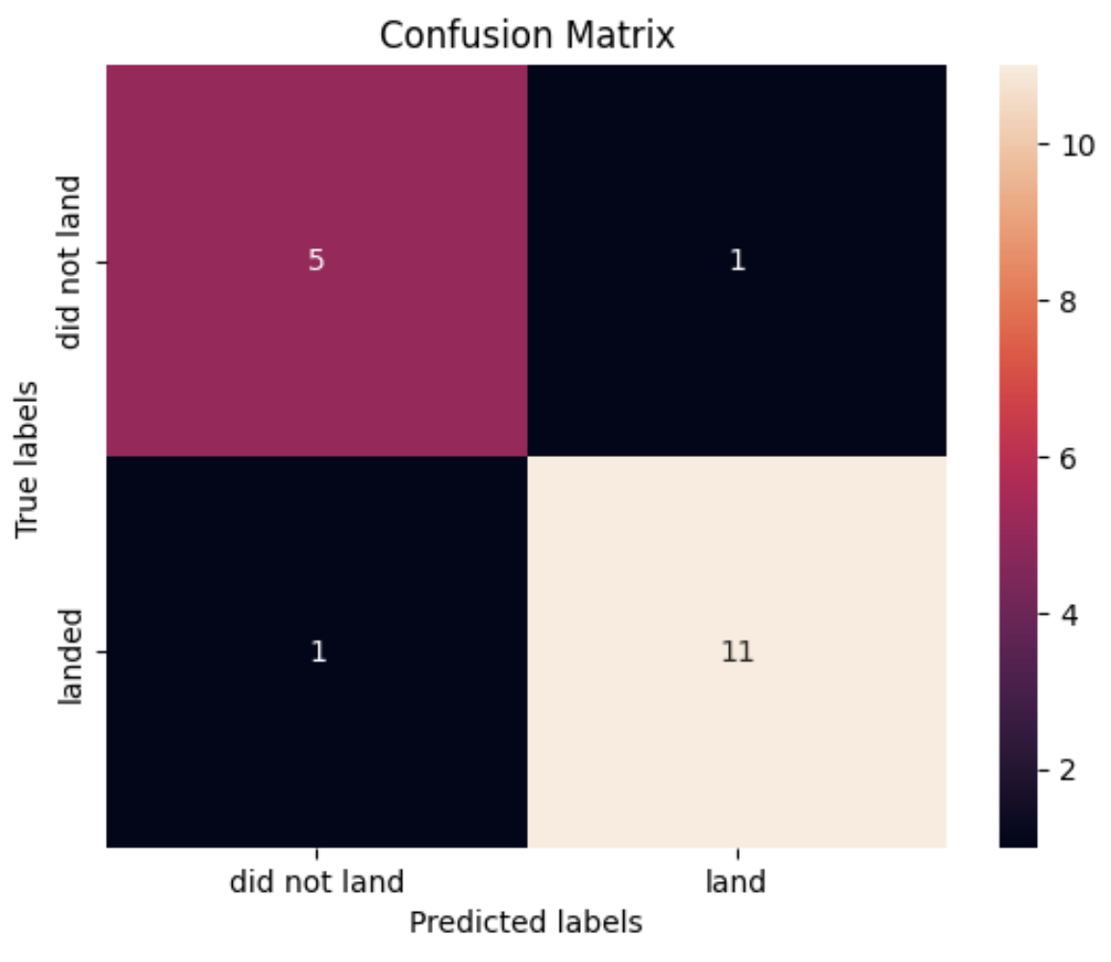
Confusion Matrix
We can see that overall, the model predicted a success and failure correctly 16 times out of the 18.
This shows good accuracy for the Decision Tree Model.

Slide 45
Conclusions
Location of Launch Site is important.
There is a range of payload mass where we can aim for to get the best results.
For our predictive model we want to use the decision tree method.
Initial failure as our own rocket is built should be calculated into the start-up for the company.
Long term, following a similar model as SpaceX another company can be competitive as right now there is minimal competition in this market space.

Slide 46
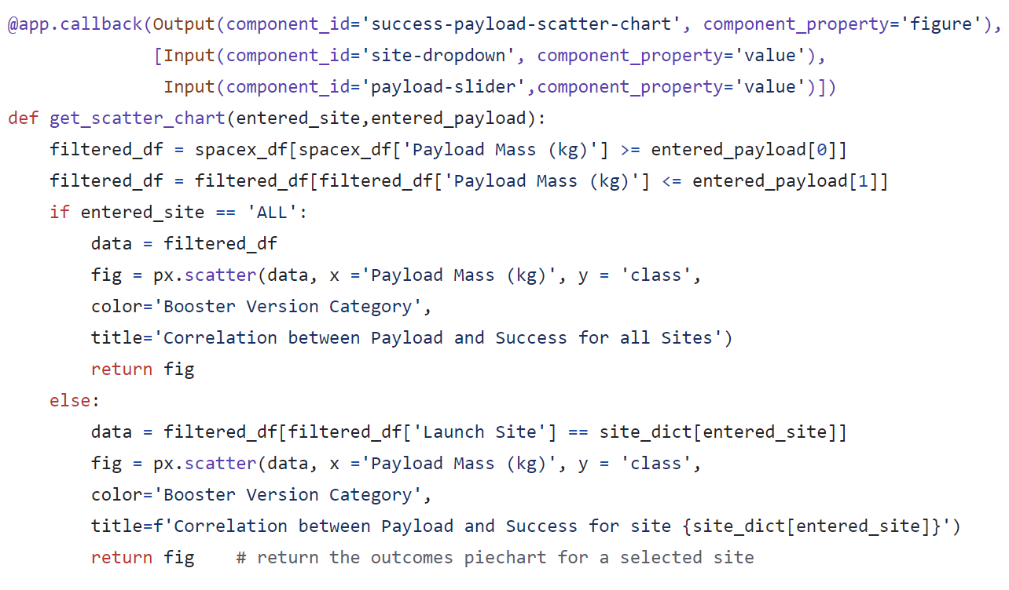
Appendix
All python code can be found on Github
Plotly Dashboard Python Code Snippet:

Slide 47


